Slide 1
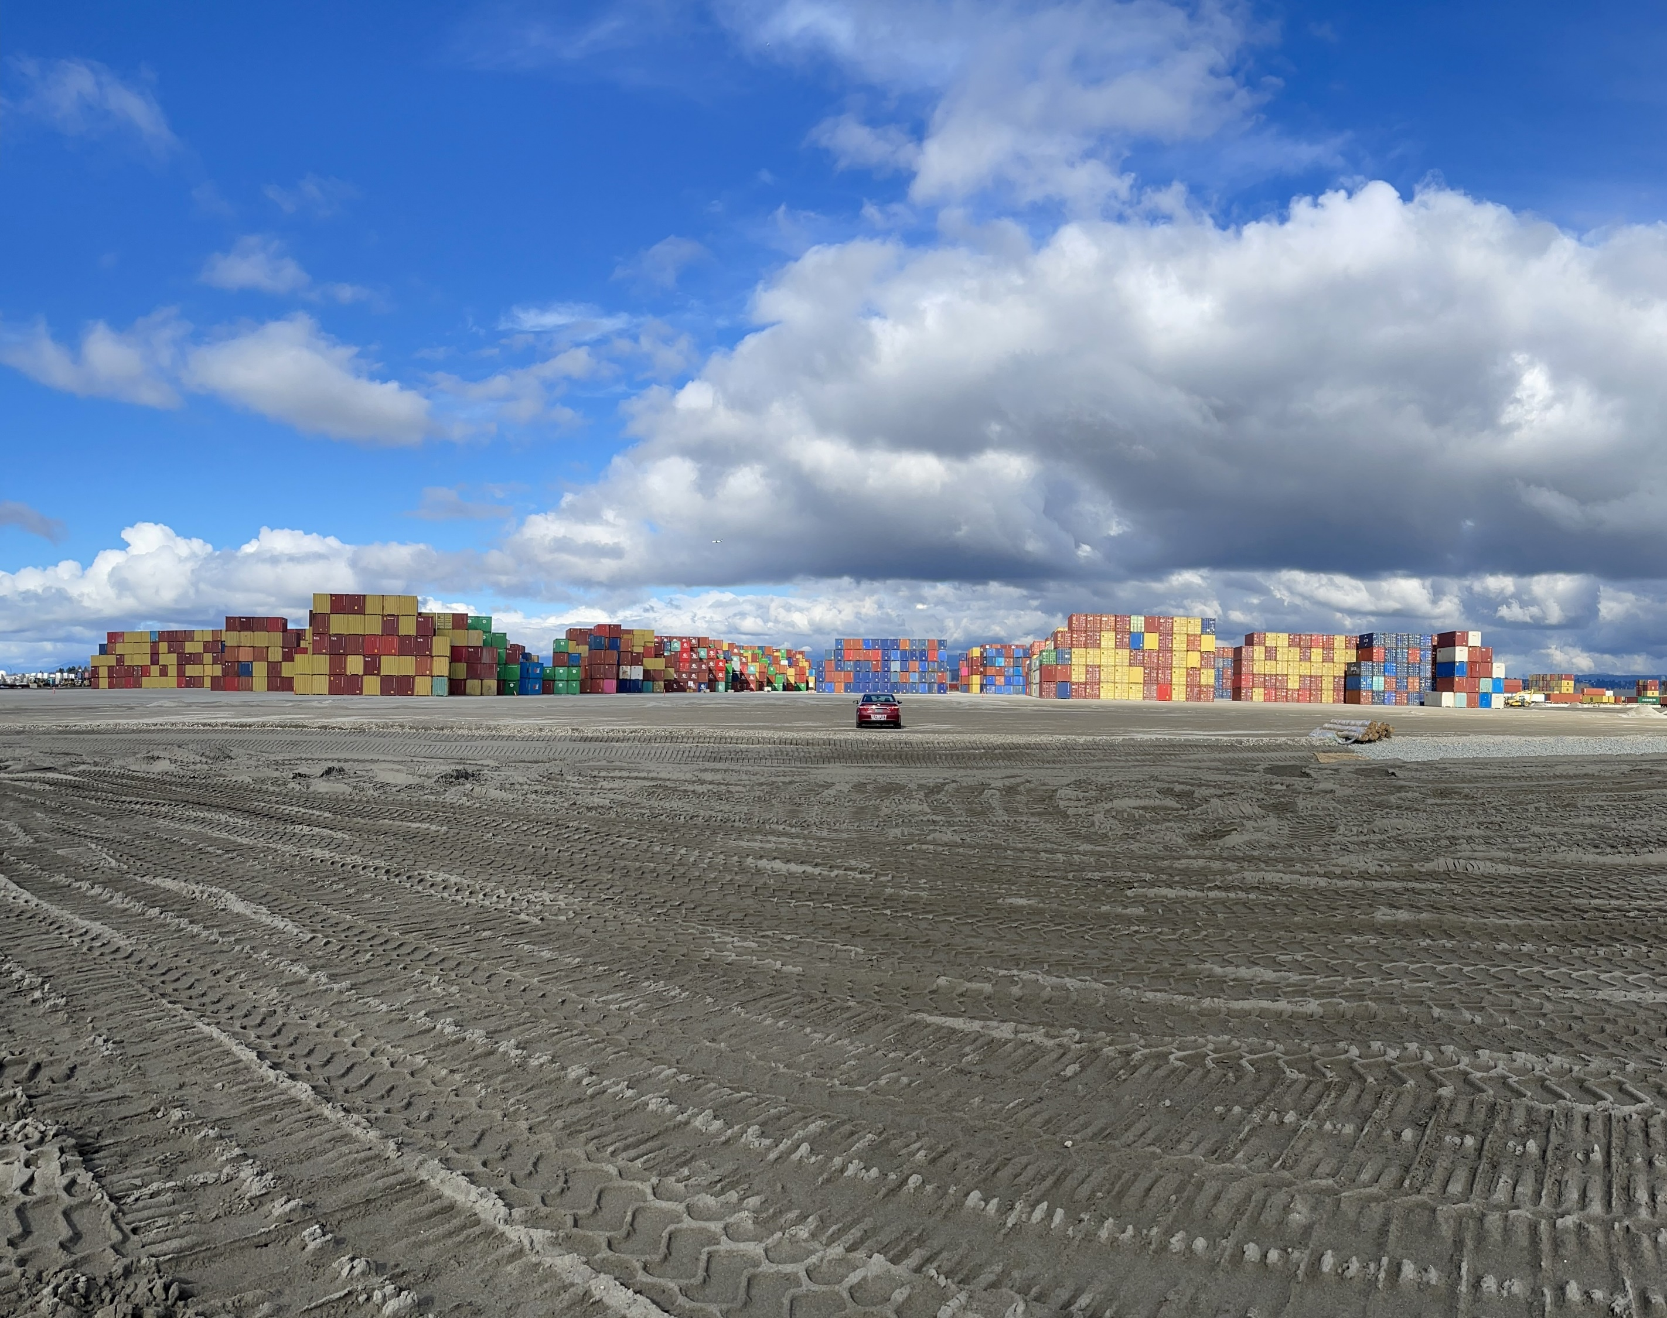
BDS TEAM SECURITY INC.
Task is once begun,
Never leave it undone.
Email: bdsteamsec@gmail.com
7404 King George BLVD.,Suite 200,Surrey,V3W 1N6

Slide 2
ABOUT US
Serving Since 2019, in Security Industry, BDS is a Team of Trained Security Professionals which ensure you the finest Security Services at different Levels.

Slide 3
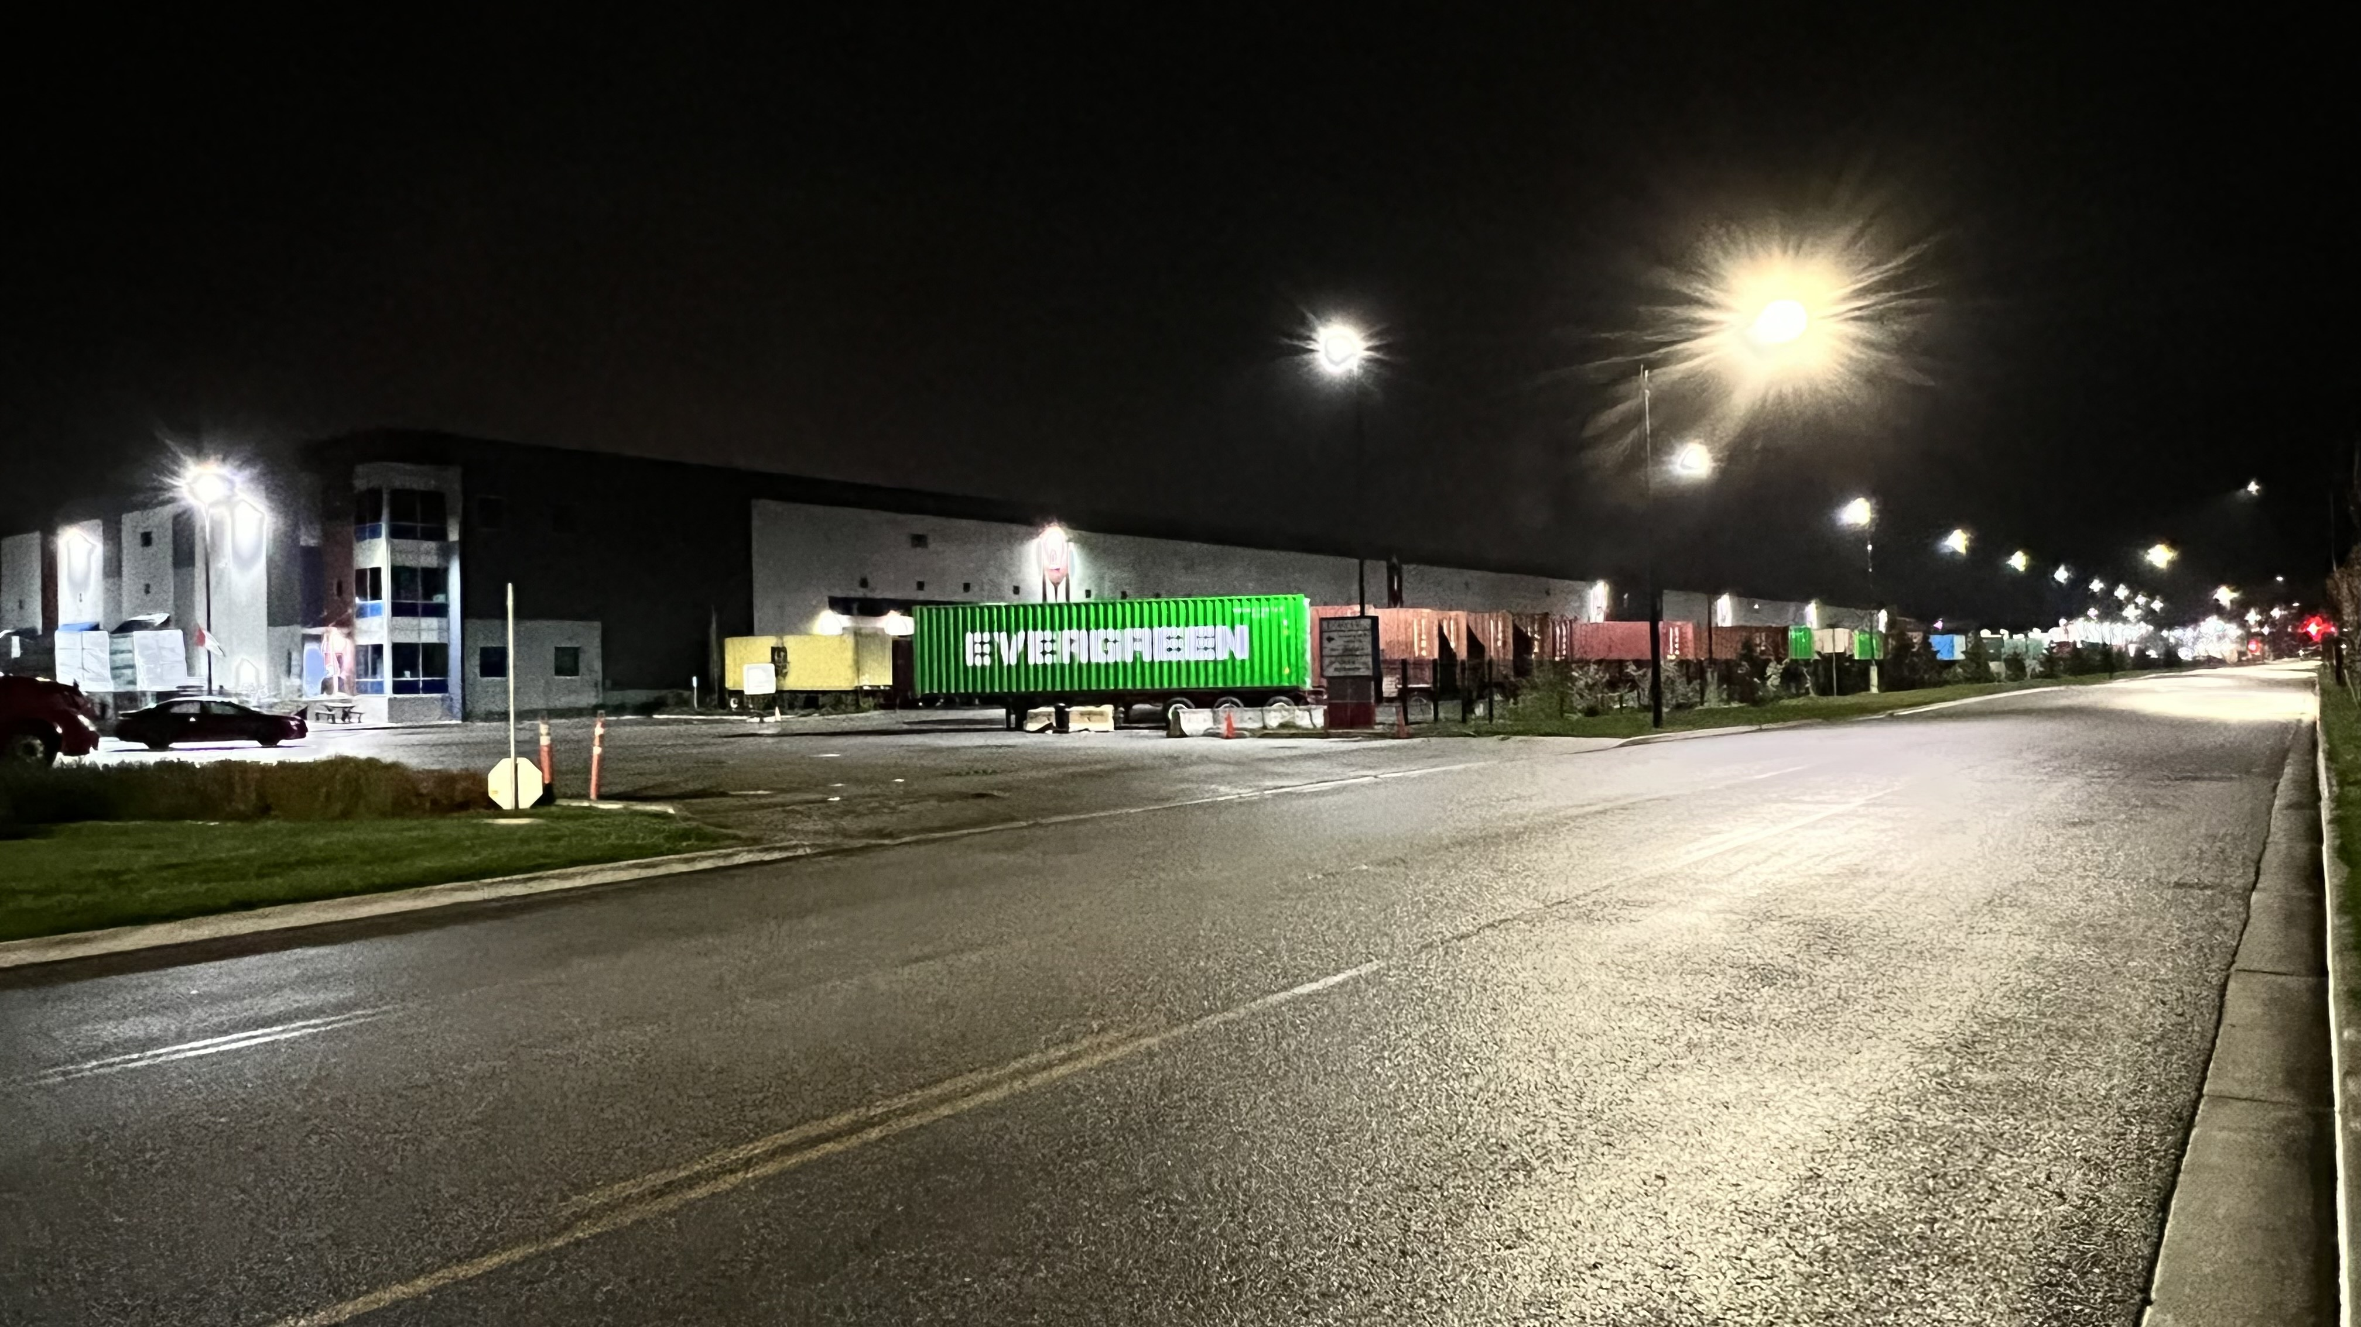
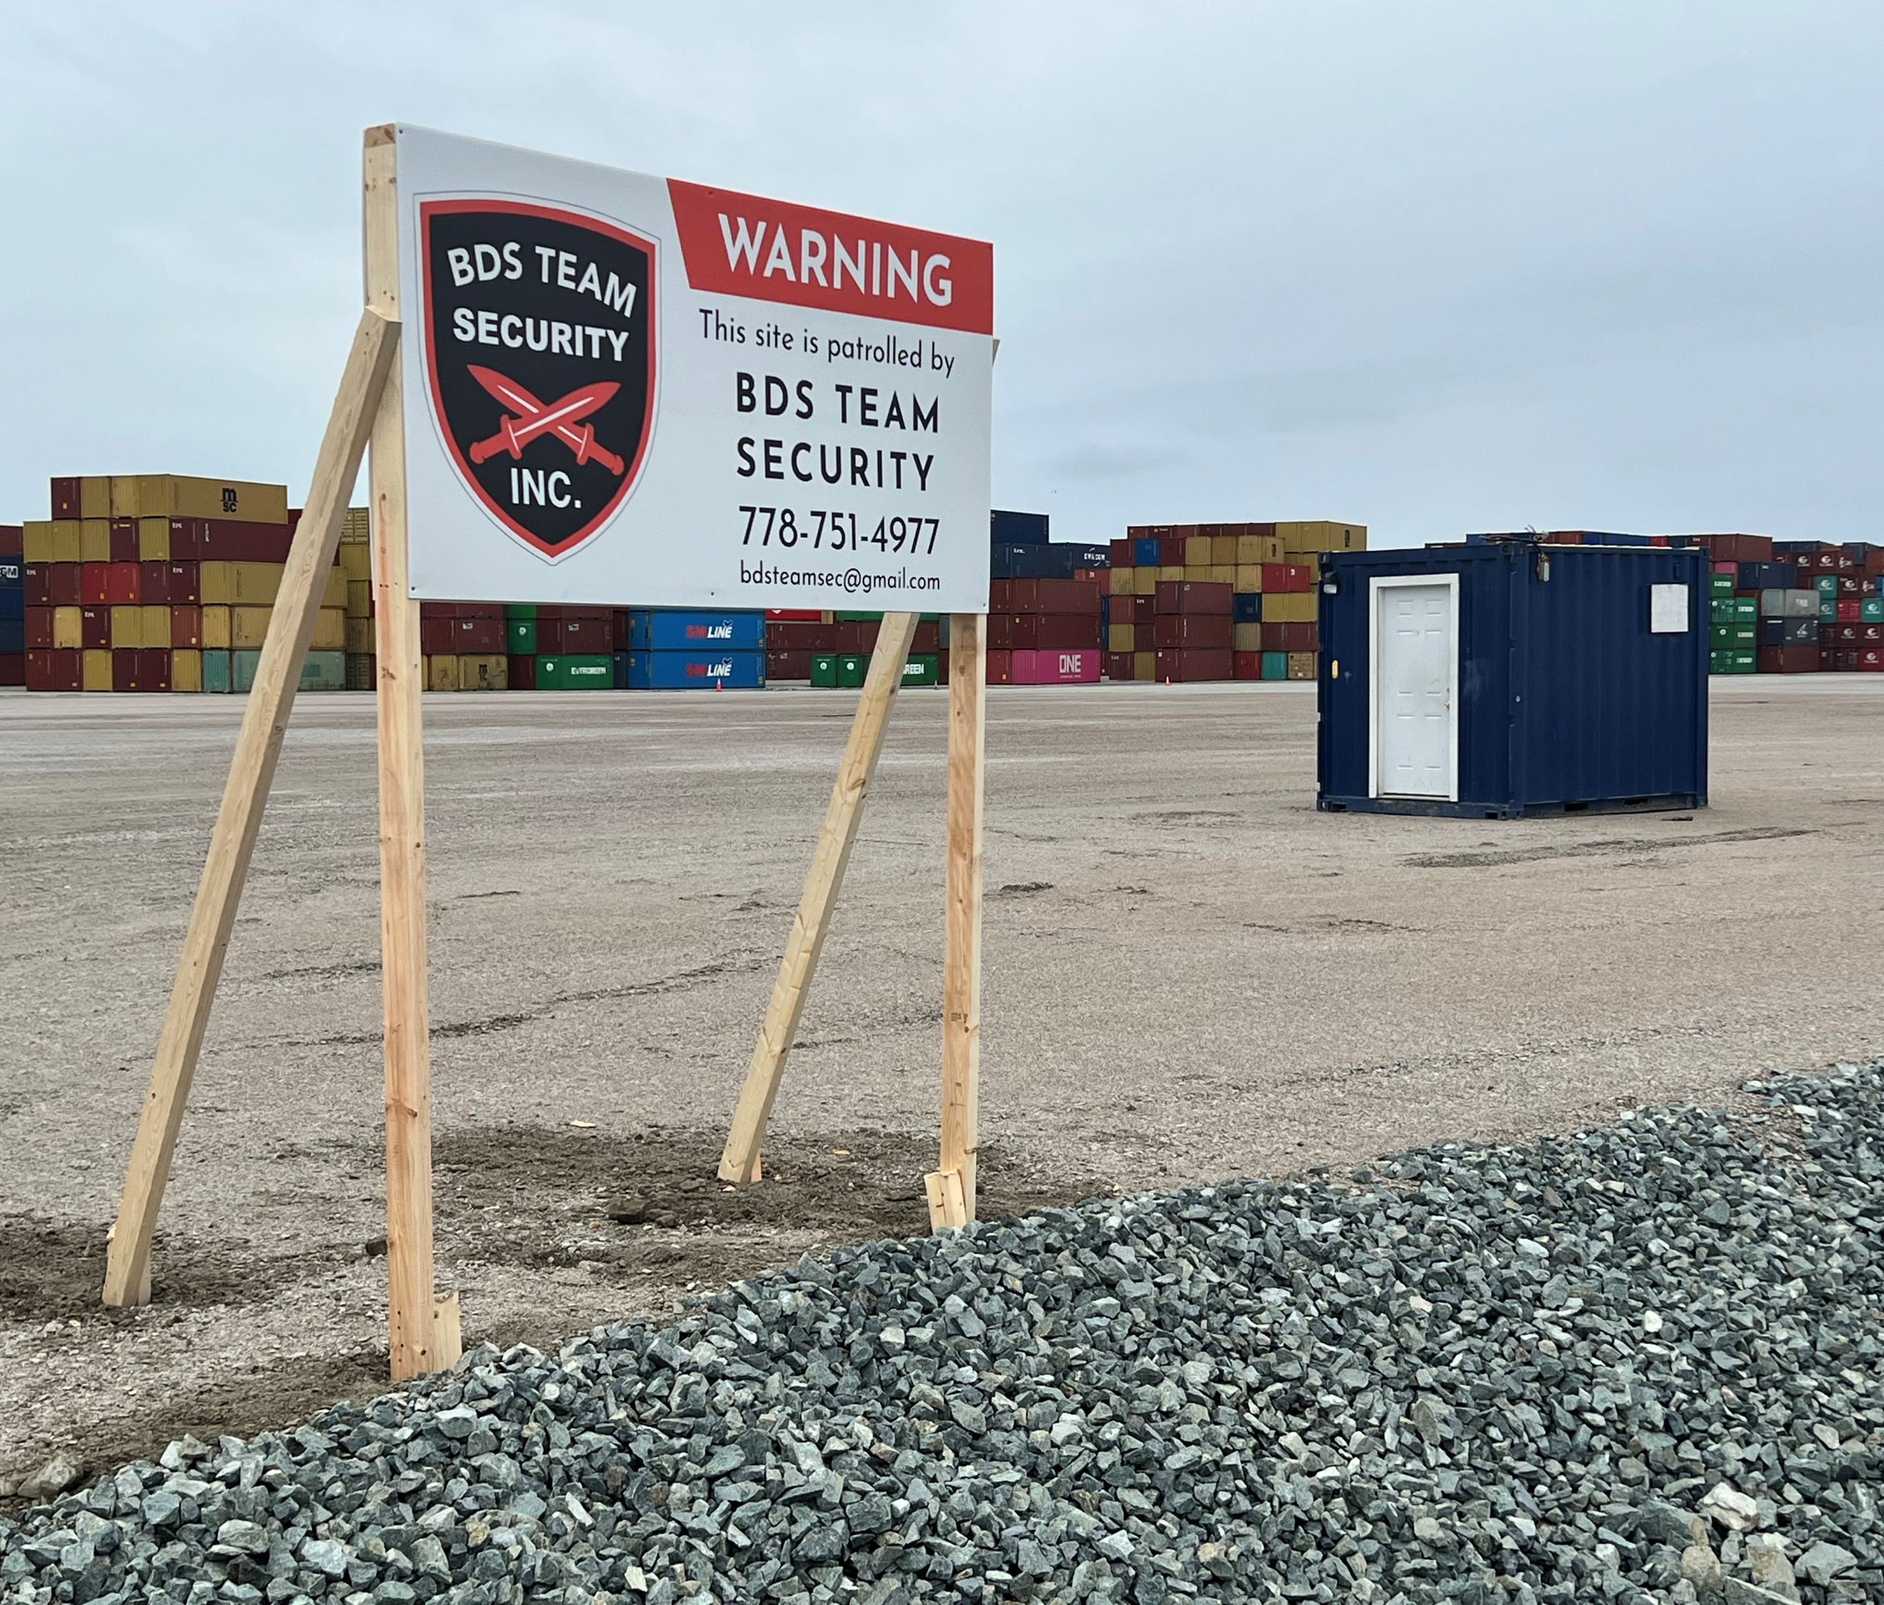
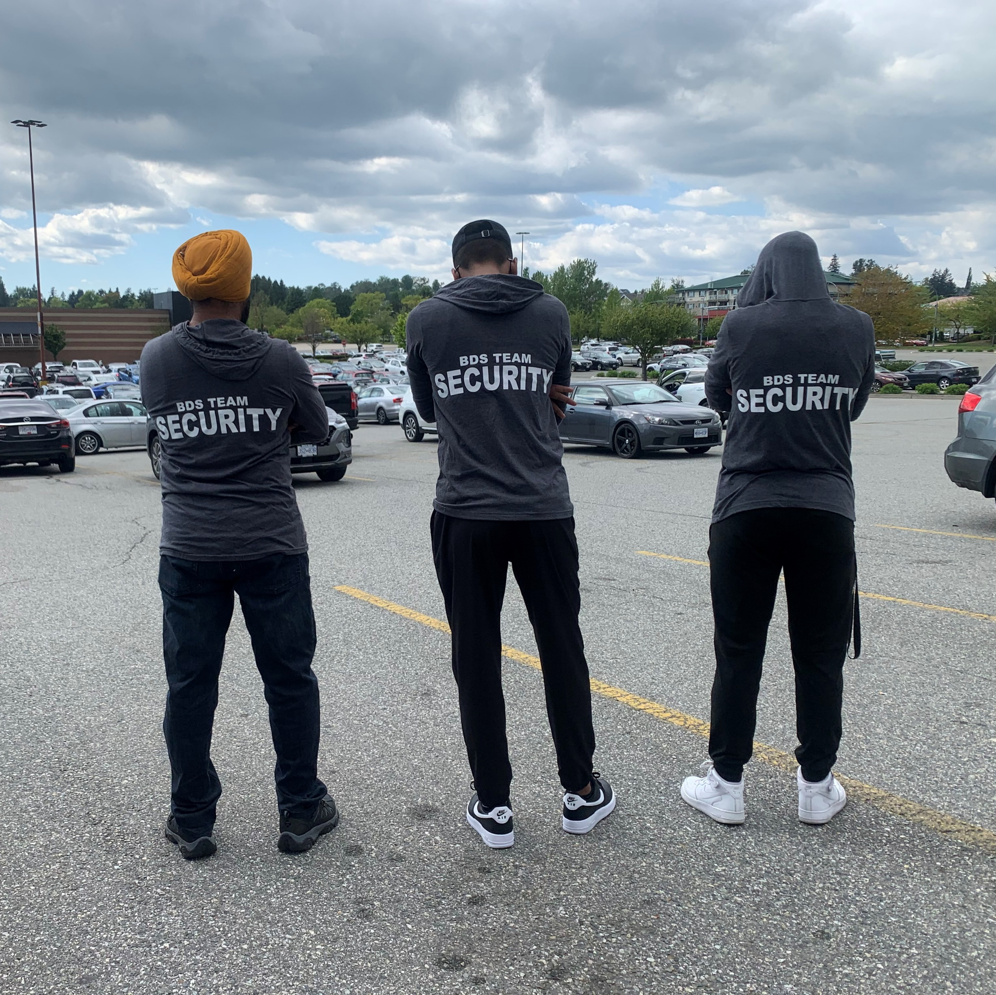
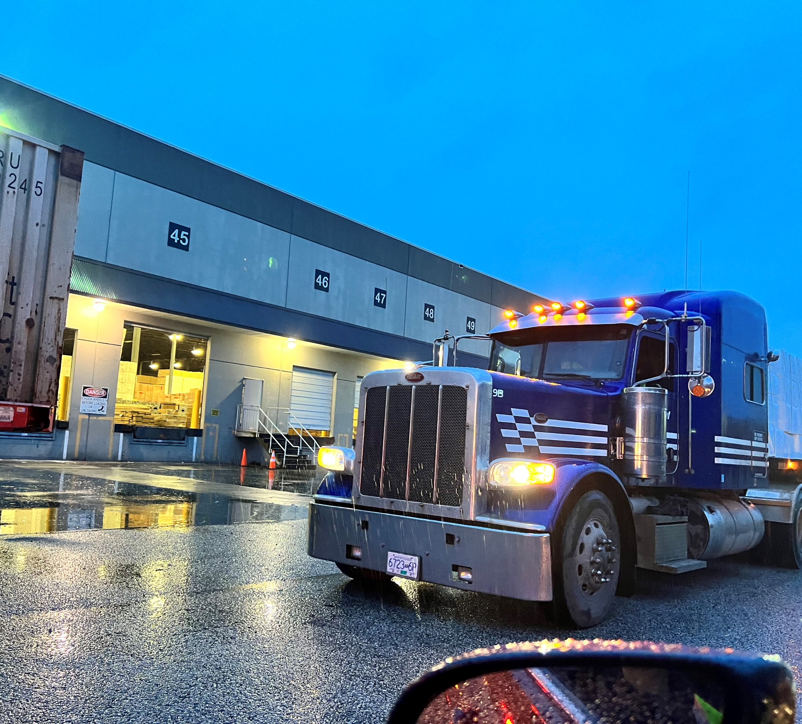
Services Provided by BDS TEAM
Since We Established, We Are Providing Exceptional Services In Broad Range Of Different Environment SUCH AS :
INDUSTRIAL SECURITY SERVICES
WAREHOUSE SECURITY SERVICES
MALL AND RETAIL SECURITY SERVICES
PARKING ENFORCEMENT SERVICES
CONTAINER YARD SERVICES

Slide 4
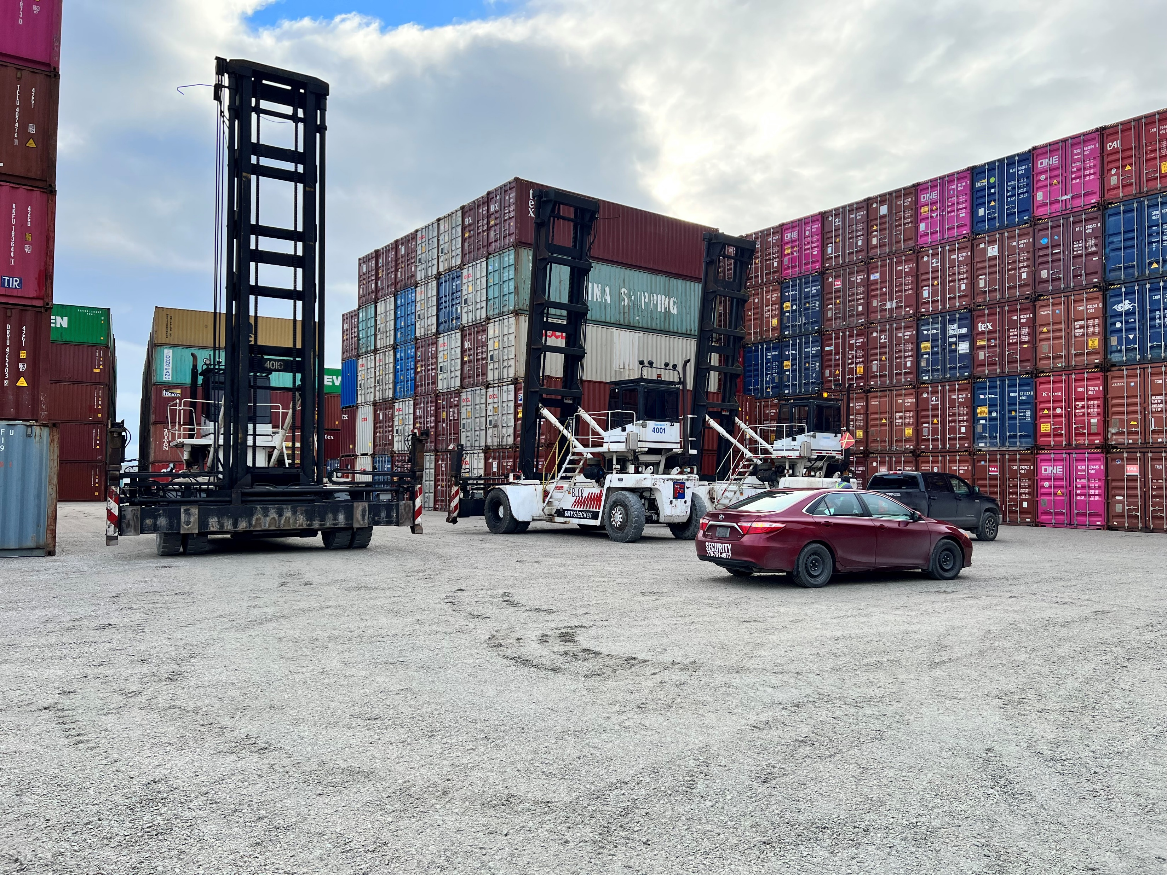
ONSITE SERVICES
Onsite According to Customer’s requirement, we provided
Stat Security
On Foot Patrolling
Car Patrolling

Slide 5
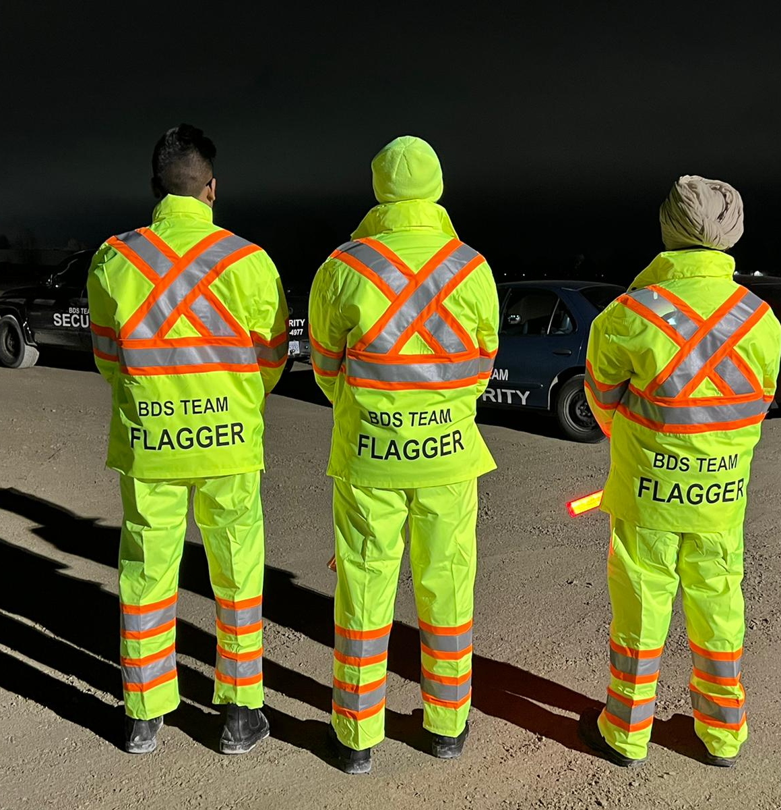
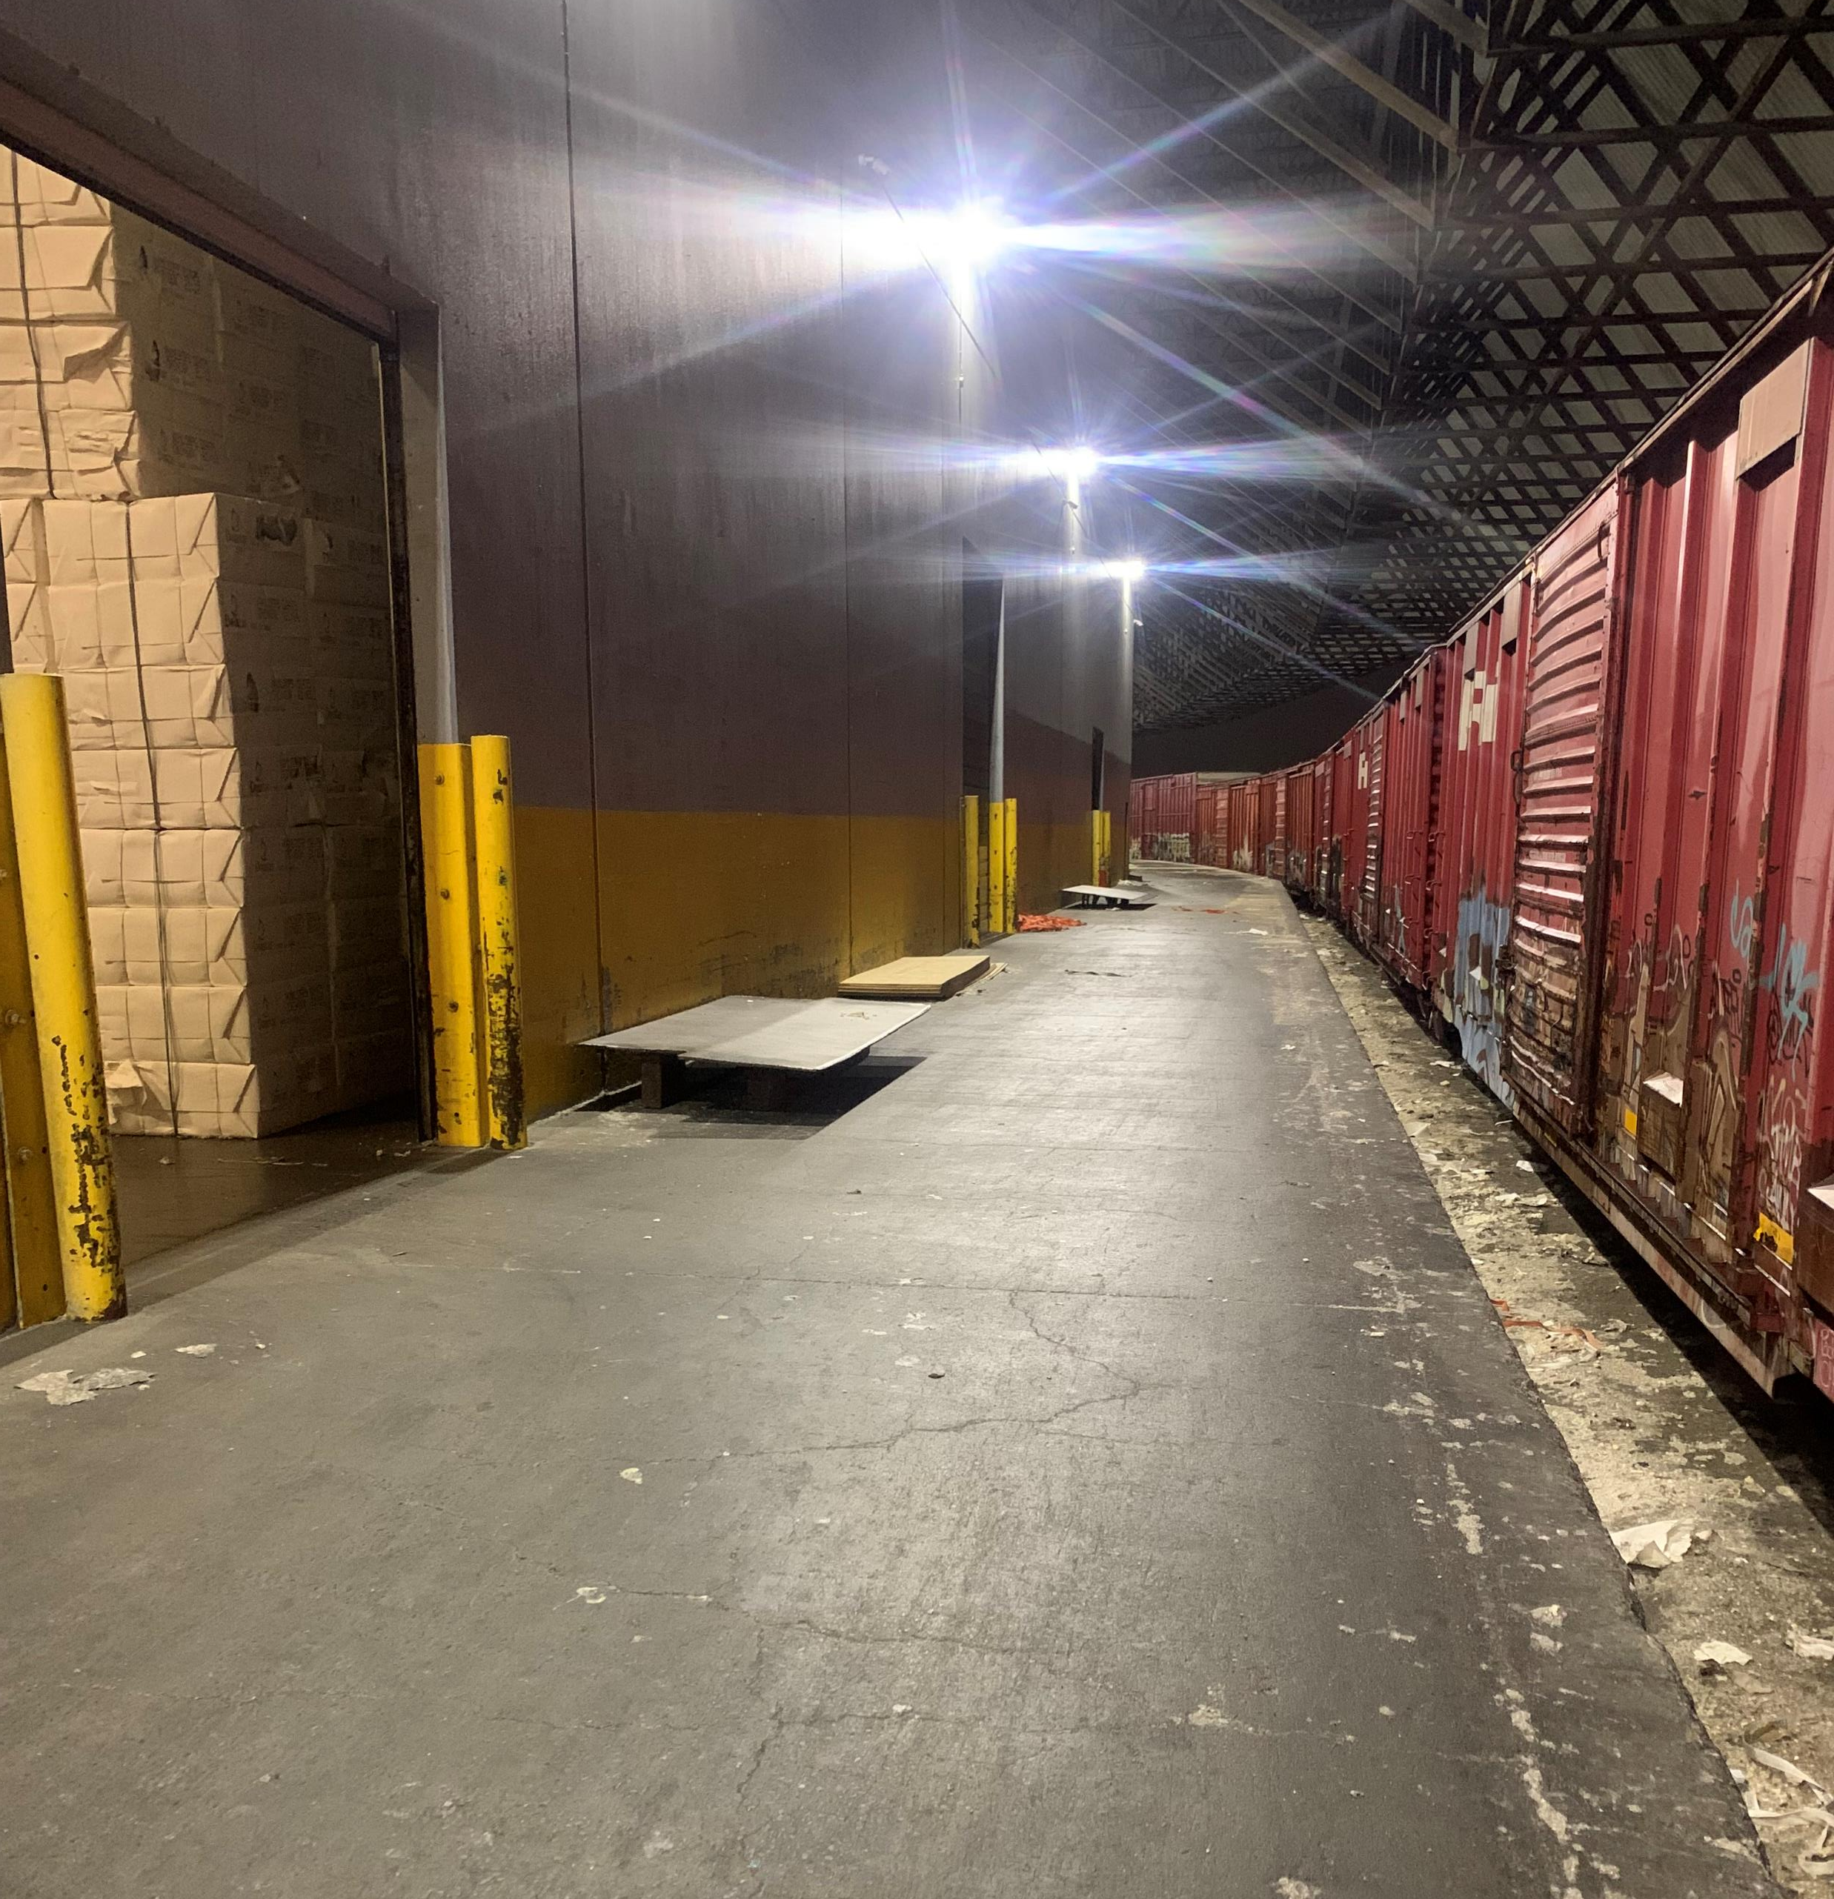
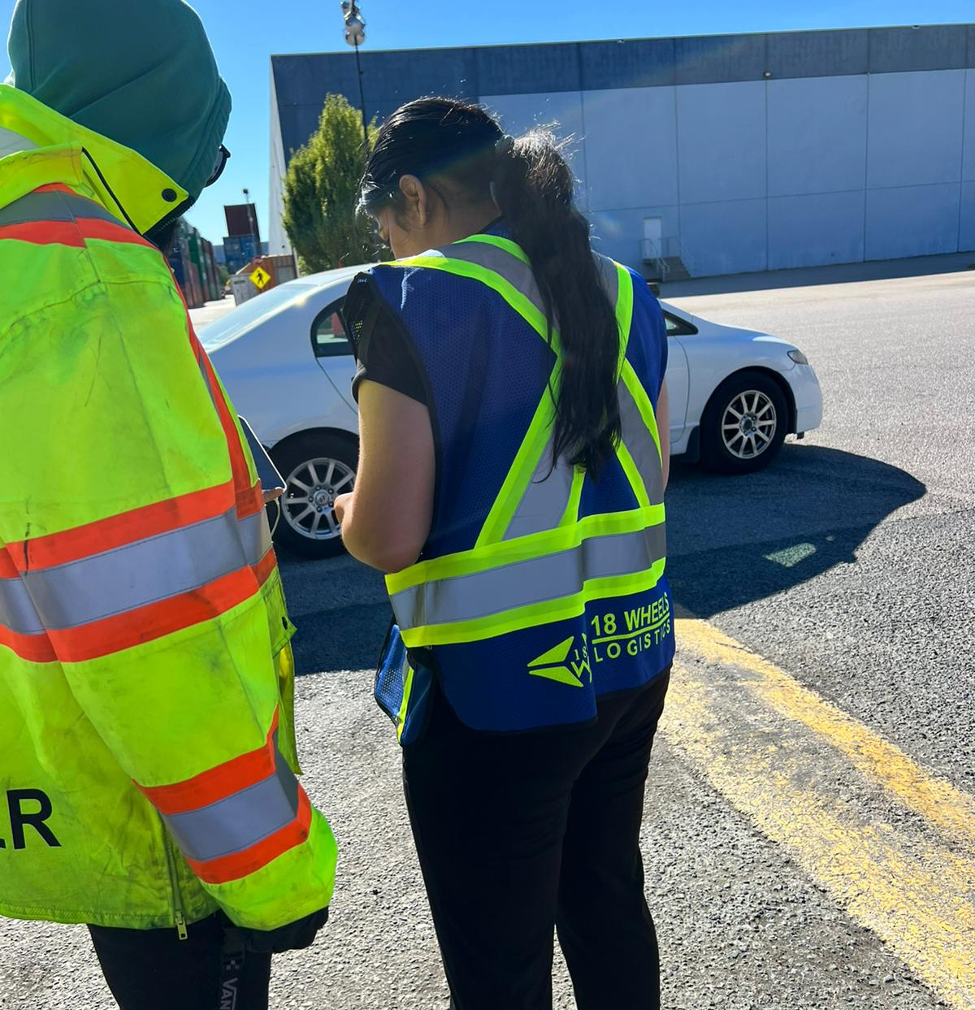
Certified TCP Personnel's
UNLOADING CREWS FOR RAIL&TRAILERS
Special Inspection Team for Warehouse & Site
Additional Services Provided by Us

Slide 6
OUR & to achieve
In Order to Achieve our BDS TEAM’S Philosophy to achieve Goal is :
Recruit, Retain and Represent the most qualified Security Personnel in Industry.
Stay Competitive by Keeping COSTS LOW in order to give quality
Providing our Personnel with Continue Training, Education and Training Program so they can be updated and be ready to Takeover anytime.
Match our Services and standards to meet or exceed client’s need and demand.
We not into quality as we personally know Our Team have so much.
In order to secure business or firm we always go with easy and effective way.
Client :
Our Mission is to provide and fulfill our Clientele’s requirement with superior service that is consistent with their ever changing security and Protection Needs
Firm’s Prospective:
However, In Mission we prioritize our Youth/Students as well. As Youth’s dedication and determination’s consider as to be a backbone of the Company.
Starting of the company the Director took a decision to Provide more opportunities to international students and Elderly People as it will give them a chance for more Opportunities and simultaneously they will have a Consistent Employment.

Slide 7
We Insure You
Clientele’s Insurance
Employee’s Insurance
Well, Coverage for Client’s been also provided by BDS TEAM.
We hold harmless the client and it’s assets, from all the liability and damages, including cost of defense sustained by any person arising out of the negligence or misconduct of the contractor or its guard.
The Liability of the contractor to the client and it’s assets is ($5,000,000,00) per occurrence. So Yes, We Assure and Insure you at the same time.
Employee’s insurance plays a pivotal role in a Employee’s working life.
Every worker in BC is covered for any work-related injury, illness, or disease. When workers suffer work-related injuries, illnesses, or diseases, we offer benefits and services that include compensation and support for their recovery, rehabilitation, and safe return to work.

Slide 8
OUR BDS TEAM

Slide 9
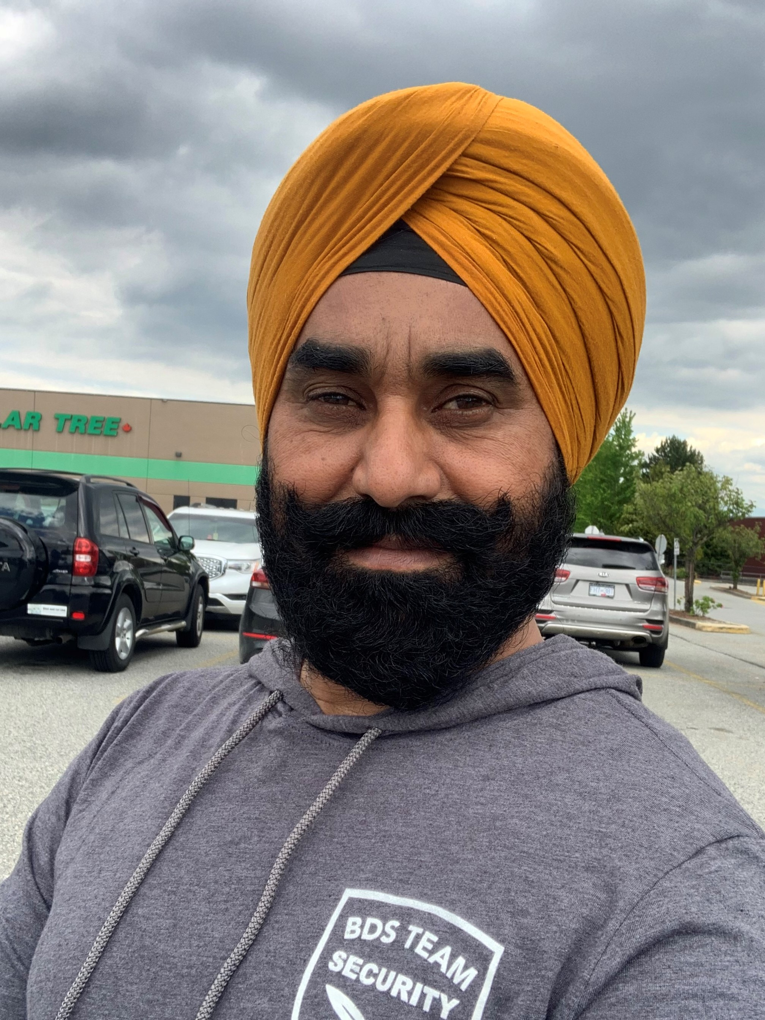
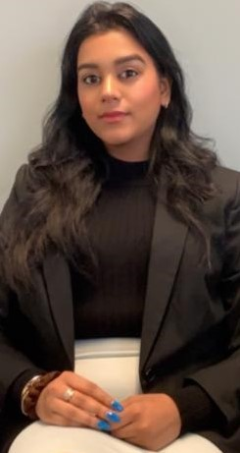
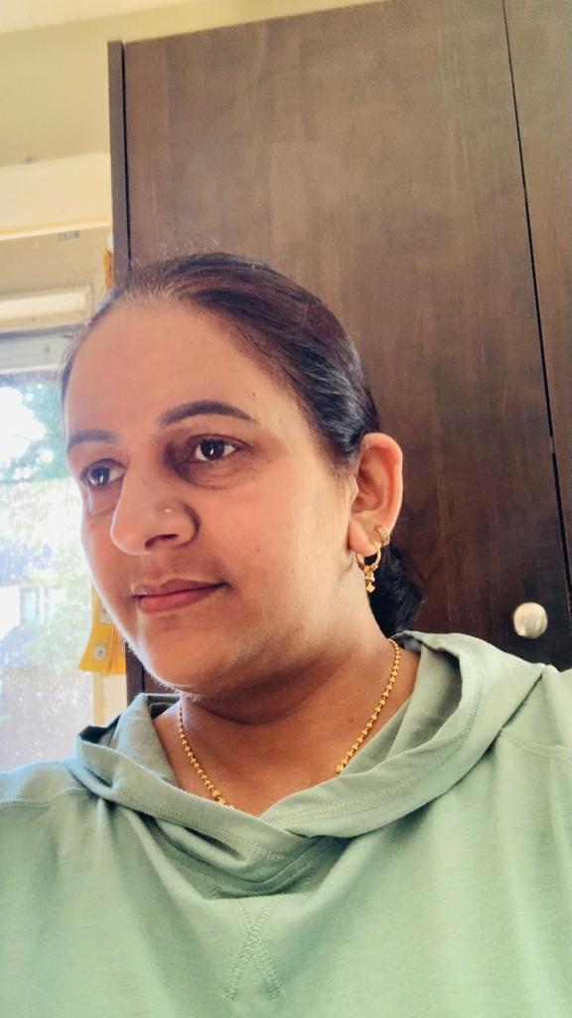
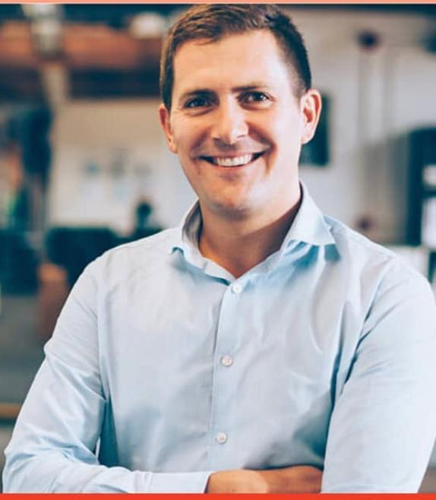
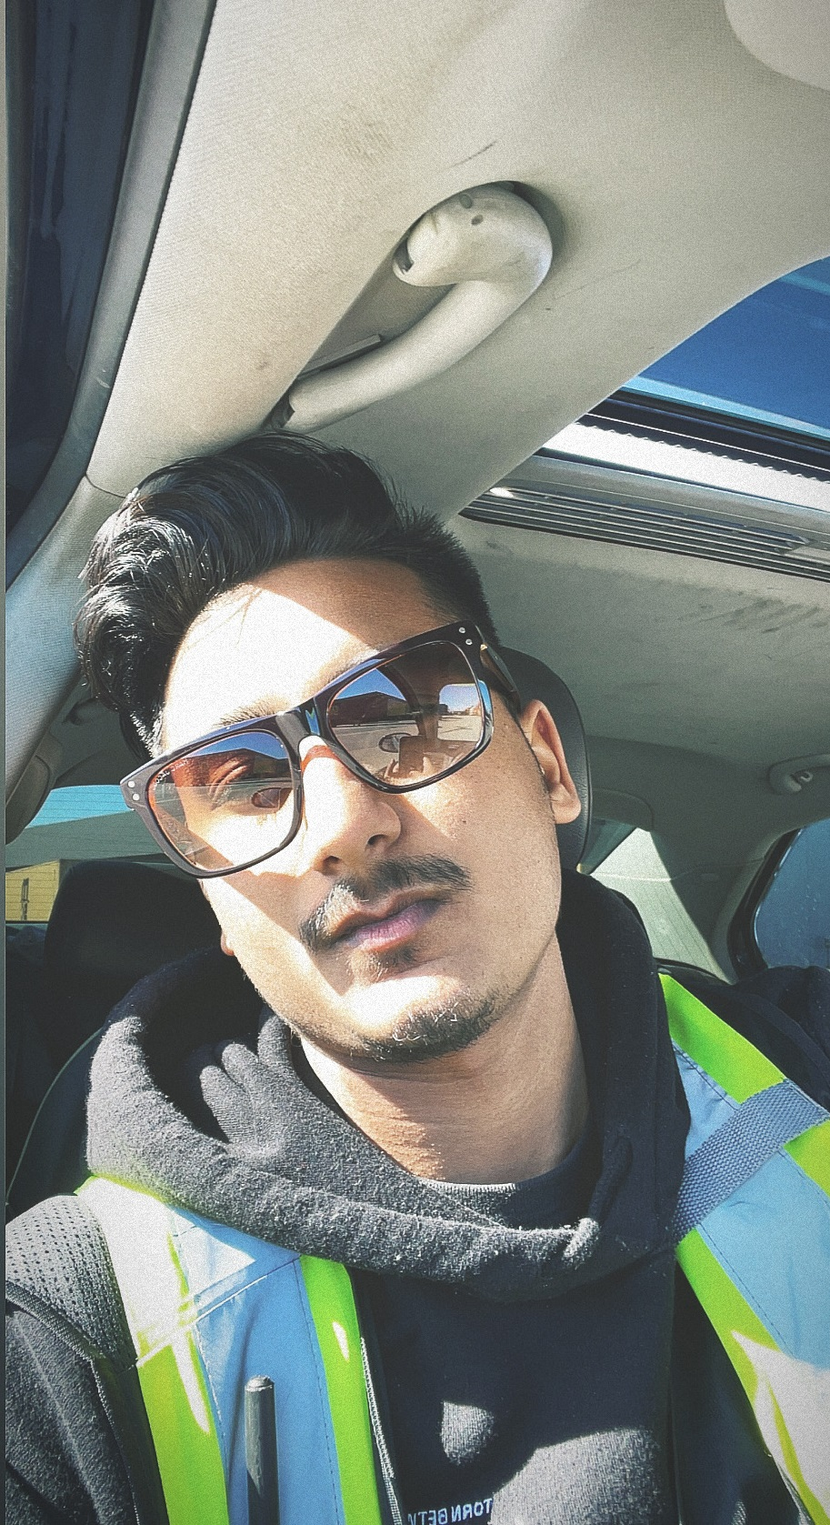
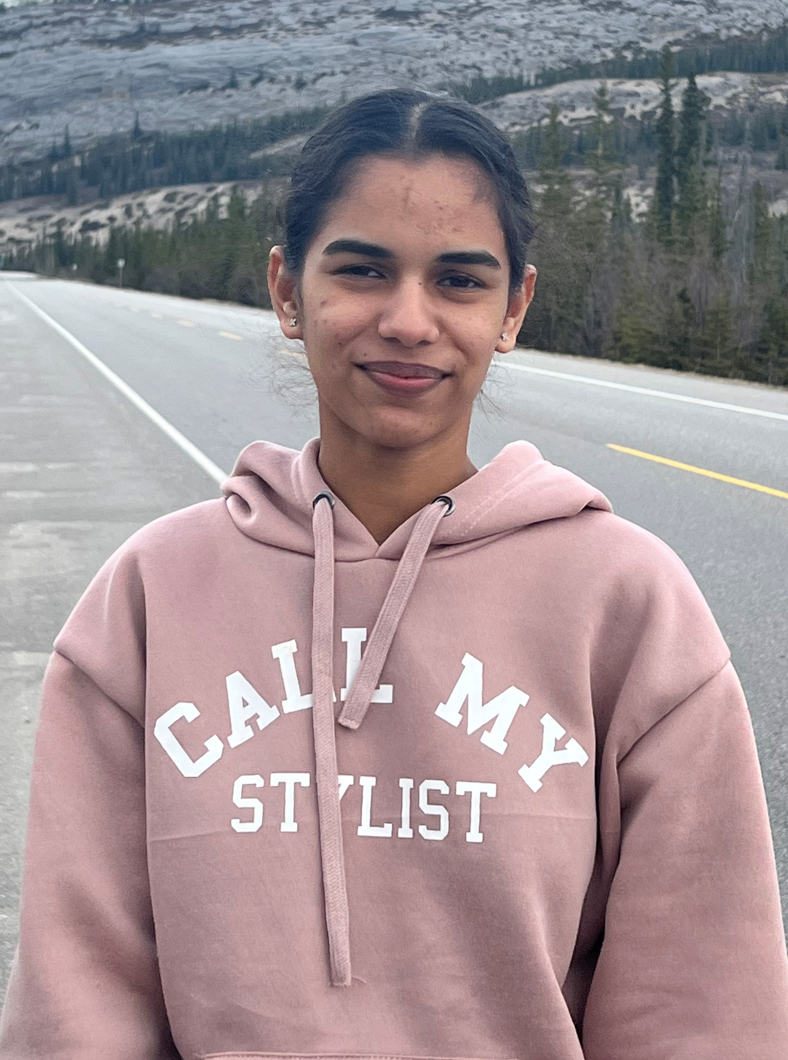
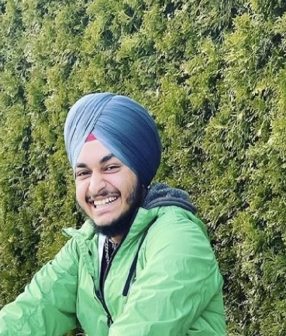
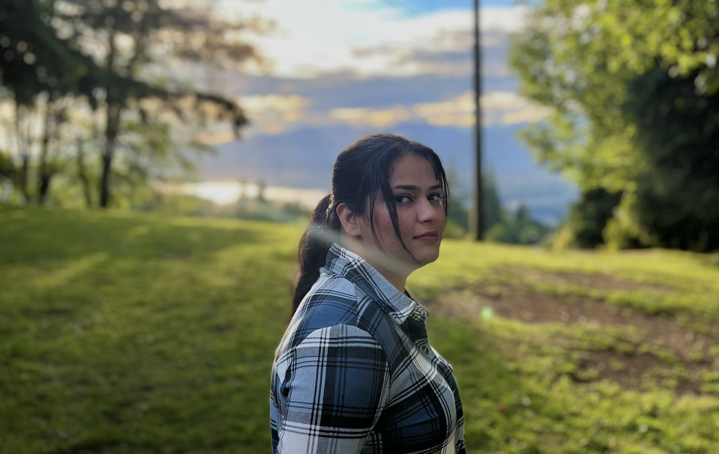
Co – Ordinator
Sarbjit
Dosanjh
Assistant Manager :
Nick Aatli
Director : Ajmer.S.
Shera
Operation Manager : Tanisha Sharma
Dispatch&Co - Ordinator:
Gurkirat.S
Transport In charge and
Co-Ordinator
BDS’s Account’s Management : Sukhan Maan and Dilpreet Dosanjh
Sahijbir.Shergill

Slide 10
THANKYOU & REGARDS

